Slide 1

Synthetic data in financial time series
Capstone Project – ITC6421B1
Stamatios Lykos
Alkiviadis Kariotis
Konstantinos Kogias
Evangelos Tsilikas
Supervisor: D r.Elena Chatzimihali

Slide 2




Authors
Stamatis Lykos
Alkiviadis Kariotis
Konstantinos Kogias
Evangelos Tsilikas
Notes:
Happy to be here with a student of mine –
Co-founder of a tech startup and a Data Analyst at Aegean airlines

Slide 3
What are synthetic data

Slide 4
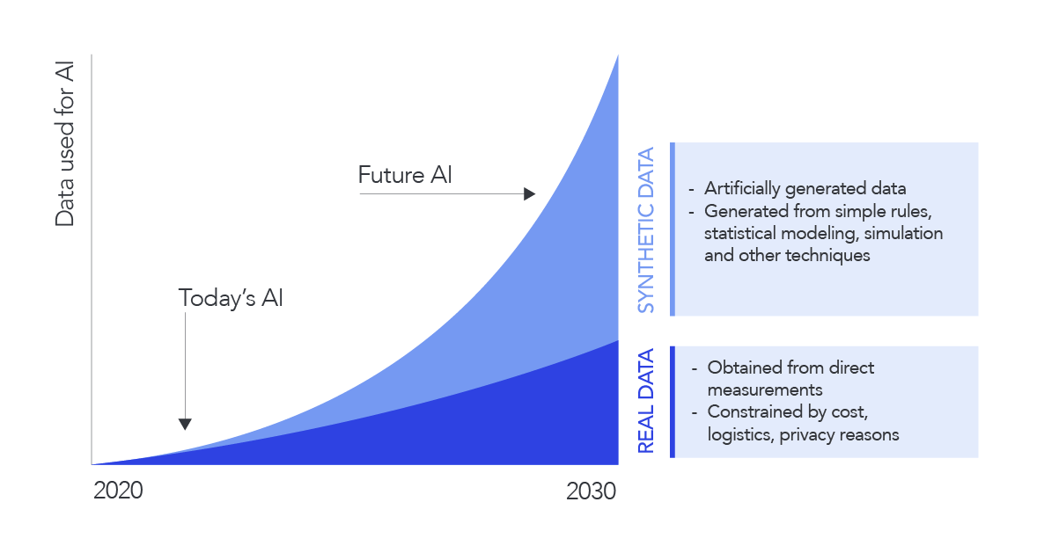
What are synthetic data
Artificially generated data that mimic real-world data: the data is not captured, measured, or recorded from the real world. Instead, algorithms or software were used to create or generate this data.
Notes:
Synthetic data are artificially generated data that mimic real-world data. These data can be created through various methods such as simulations, algorithms, or statistical models. The primary purpose of synthetic data is to provide a substitute for real data in situations where real data are scarce, sensitive, or expensive to obtain.
Trending thing– you will need it
Overt the years will surpass the need of real data

Slide 5
Why do we need synthetic data
Can be generated to train or evaluate ML models under certain conditions that are usually hard to capture in the real world.
For scenarios where collecting and annotating data is expensive.
When the real data is limited or absent.
Ethical considerations
Privacy issues
Notes:
While real data can be very valuable, it may not be easily available.

Slide 6
Why synthetic data in finance
Regulatory Compliance and Privacy
Risk Management
Fraud detection

Slide 7
Data SOURCE
FRED (Federal Reserve Economic Data)
Fredapi is a Python API for the FRED data provided by the Federal Reserve Bank of St. Louis.
Fredapi provides a wrapper in Python to the FRED web service, and also provides several convenient methods for parsing and analyzing point-in-time data (i.e. historic data revisions) from ALFRED (Archival economic data St. Louis Fed)

Slide 8
Implemented synthetic data methods
Data Augmentation Techniques
Variational Autoencoders (VAEs)
Generative Adversarial Networks (GANs)
Recurrent Neural Networks (RNNs) and Long Short-Term Memory (LSTM)
Notes:
We implemented 1-2 and they were not enough ;

Slide 9
GENERATIVE ADVERSARIAL NETWORK

Slide 10
How it works
Unsupervised learning techniques where both sub models are trained simultaneously using a process called adversarial training
A typical GAN consists of two neural networks (usually convolutional neural networks): the generator and the discriminator.
Both the generator and discriminator are constantly trying to improve their performance, resulting in the generation of increasingly realistic synthetic data.

Slide 11
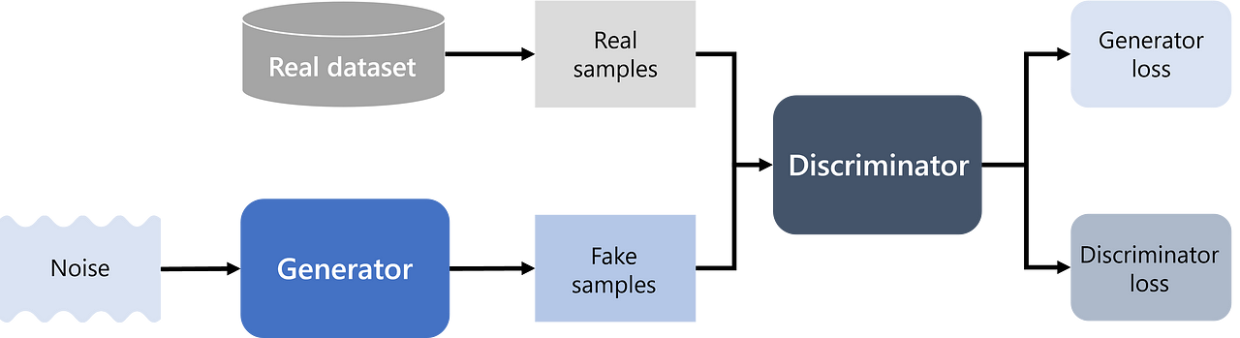
Step by step training process
Create z by sampling a random noise following a suitable noise distribution such as uniform, Gaussian, Binomial, Poisson, Exponential, Gamma, and Weibull distributions.
Feed z to the generator to produce a synthetic or fake sample, x fake.
Pass both x fake and x real to a switch block, which randomly selects one of its inputs and passes it to the discriminator.

Slide 12
Step by step training process
The discriminator classifies the given sample as real or fake.
Calculate the error.
Backpropagate the error to both the generator and discriminator.
Update the weights of the generator and discriminator

Slide 13
ANO TIME – SERIES GENERATIVE ADVERSARIAL NETWORK

Slide 14
A sophisticated model designed to generate realistic time-series data by combining the strengths of both GANs (Generative Adversarial Networks) and RNNs (Recurrent Neural Networks).
The network is trained in a way that leverages both supervised and unsupervised learning to capture the temporal dynamics of the data.

Slide 15
Timeseries DATA
Time-series or sequential data can be defined as any data that has time dependency.
To model successfully time-series data means that a model must, not only capture the datasets features distributions within each time-point but also, it should be able to capture the complex dynamics of those features across time.
To generate tabular data is far simpler than generating datasets that should preserve temporal dynamics.

Slide 16
embedder
Purpose: The Embedder maps the raw time-series data into a latent space. This step helps in capturing the temporal dependencies in a lower-dimensional space.
Architecture: Typically, an RNN or LSTM network.
Process: Given an input time-series X, the Embedder produces a latent representation H.
H = E(X)

Slide 17
RECOVERY
Purpose: The Recovery network maps the latent representation back to the original time-series data space. This ensures that the latent representation contains sufficient information to reconstruct the original data.
Architecture: Often an RNN or LSTM network, mirroring the structure of the Embedder.
Process: Given the latent representation H, the Recovery network outputs the reconstructed time-series X’.
X’ = R(H)

Slide 18
GENERATOR
Purpose: The Generator produces synthetic latent representations from random noise. These latent representations should ideally mimic the distribution of the real latent representations produced by the Embedder.
Architecture: An RNN or LSTM network that takes random noise as input and outputs synthetic latent representations Hfake​.
Hfake = G(Z)

Slide 19
DISCRIMINATOR
Purpose: The Discriminator differentiates between real latent representations and synthetic ones. It ensures that the Generator produces realistic latent representations.
Architecture: A neural network (often an RNN) that takes latent representations as input and outputs a probability score indicating whether the input is real or fake.
Process: Given a latent representation H (either real or fake), the Discriminator outputs a probability score.
Real/Fake Score = D(H)

Slide 20
SUPERVISOR
Purpose: The Supervisor network is introduced to aid the Generator in capturing the temporal dynamics more effectively. It ensures that the synthetic latent representations have similar temporal properties to the real latent representations.
Architecture: An RNN or LSTM network.
Process: The Supervisor takes the synthetic latent representations Hfake​ and produces supervised latent representations Hsupervised​.
Hsupervised = S(Hfake)

Slide 21
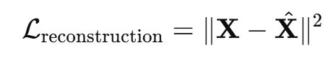
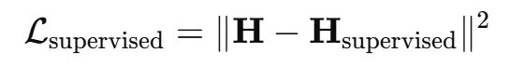
Loss functions
Reconstruction Loss: Ensures that the Embedder and Recovery networks can accurately reconstruct the original time-series data
Supervised Loss: Ensures that the Supervisor network helps the Generator produce latent representations with proper temporal dynamics.

Slide 22
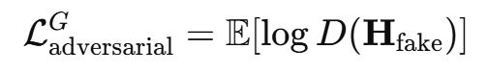
Loss functions
Adversarial Loss: Used for both the Generator and Discriminator to ensure that the Generator produces realistic latent representations.
Overall Loss: The final loss function combines all the individual losses.

Slide 23
Training steps
Step 1: Train the Embedder and Recovery networks together using the reconstruction loss.
Step 2: Train the Supervisor network using the supervised loss.
Step 3: Train the Generator and Discriminator networks using the adversarial loss.
Step 4: Fine-tune all networks together using the overall loss to ensure that all components work harmoniously.

Slide 24
Hands on - PYTHON

Slide 25
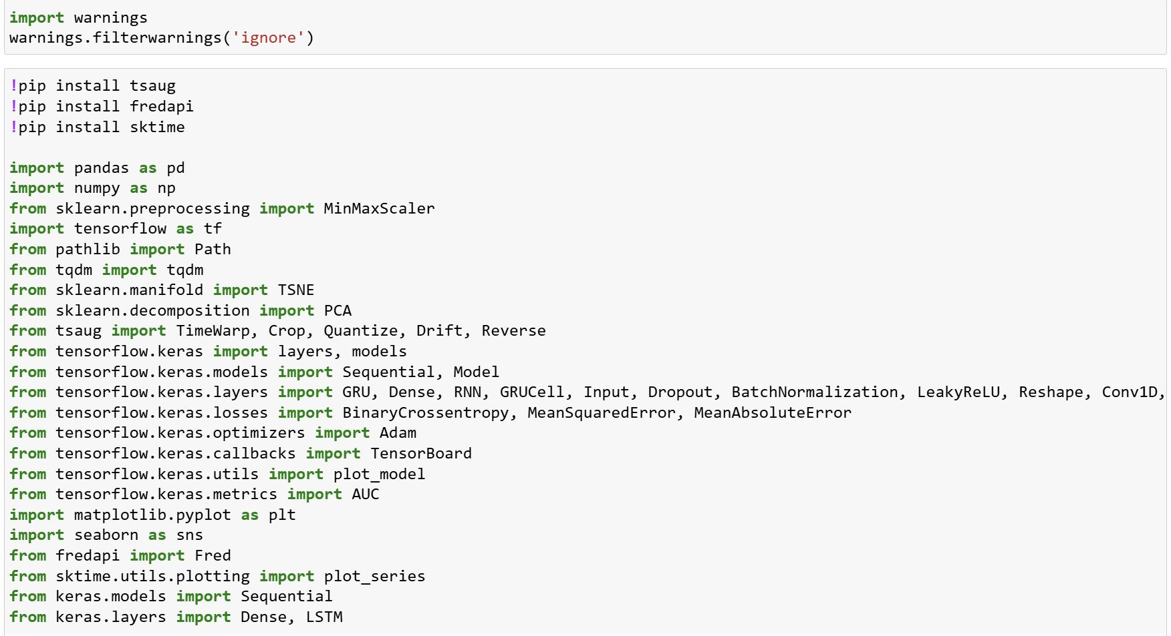
Libraries

Slide 26
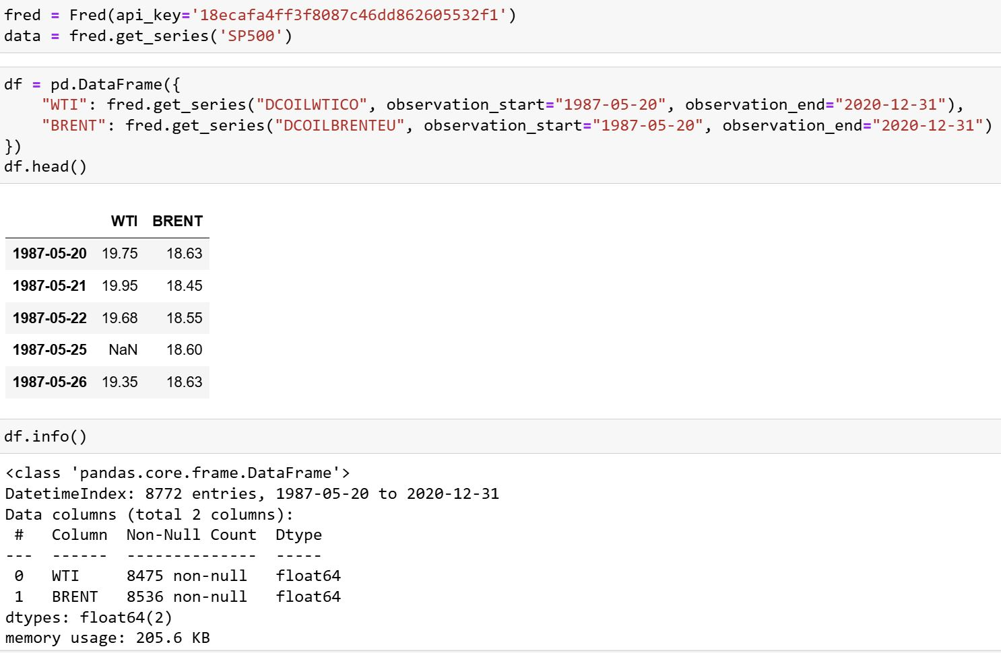
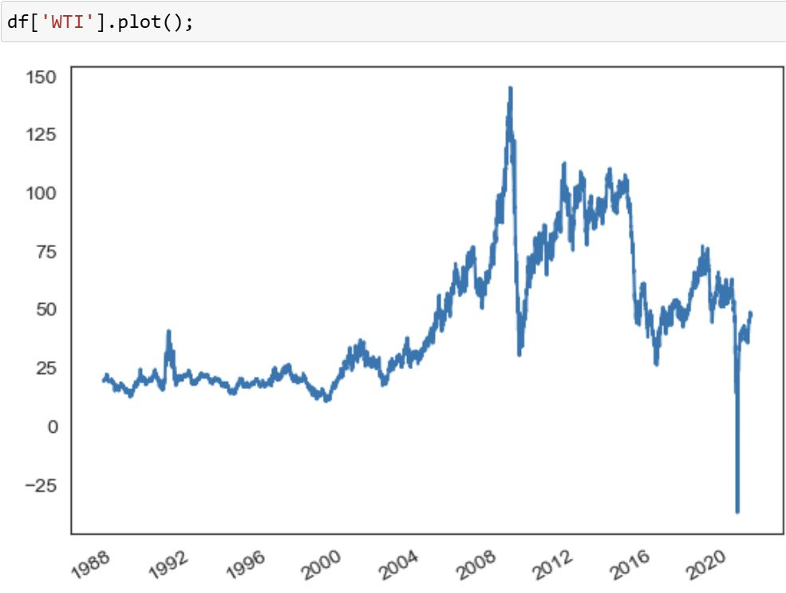
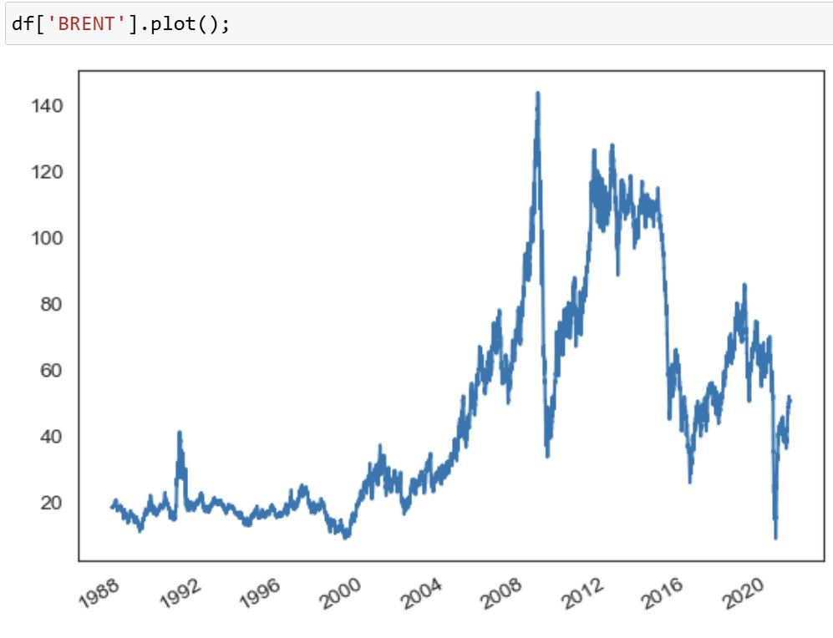
Data preparation

Slide 27
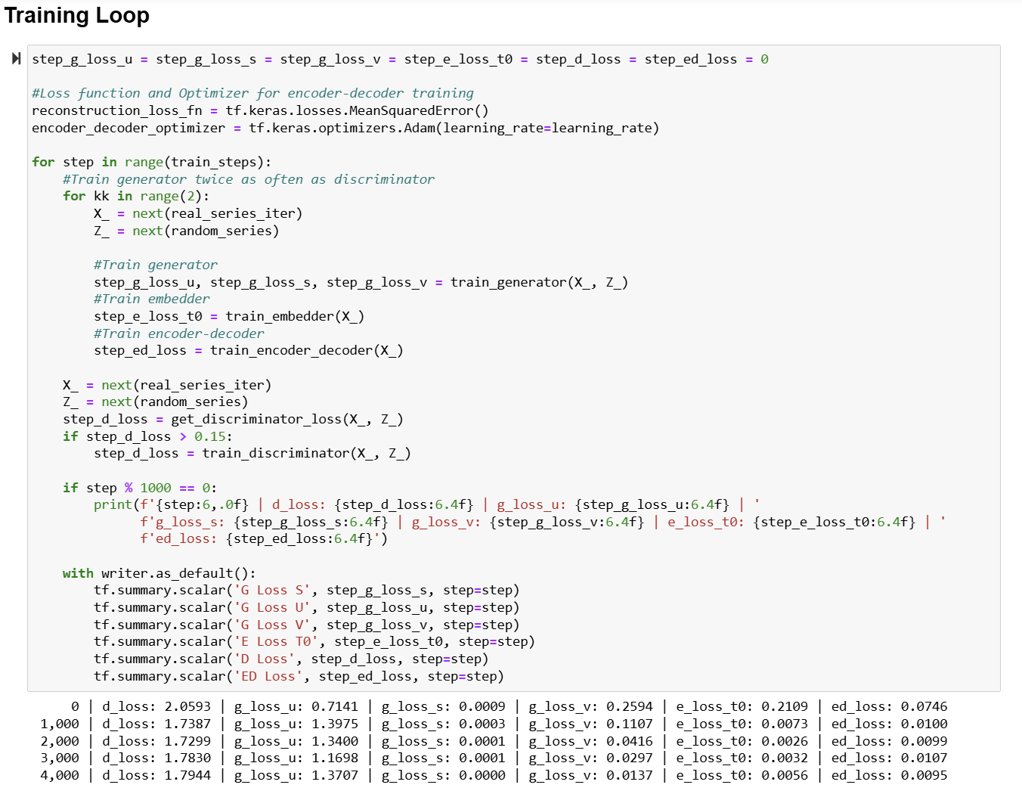
Training loop

Slide 28
Losses interpretation
Discriminator Loss (d_loss): decreases initially from 2.0593 to 1.7299 but then fluctuates around 1.78, suggesting some stability but also a potential ongoing challenge in distinguishing real from fake data.
Generator Losses (g_loss_u, g_loss_s, g_loss_v: The generator's performance improves as evidenced by g_loss_u increasing from 0.7141 to a peak of 1.3975 and stabilizing around 1.37, while g_loss_s remains very low, indicating strong supervised performance or minimal contribution. Additionally, g_loss_v steadily decreases, signifying enhanced control over sample variability.
Embedder Loss (e_loss_t0): Decreases significantly, showing the embedder effectively captures temporal structure.
Encoder-Decoder Loss (ed_loss): Starts high but drops quickly, indicating successful reconstruction of data.

Slide 29
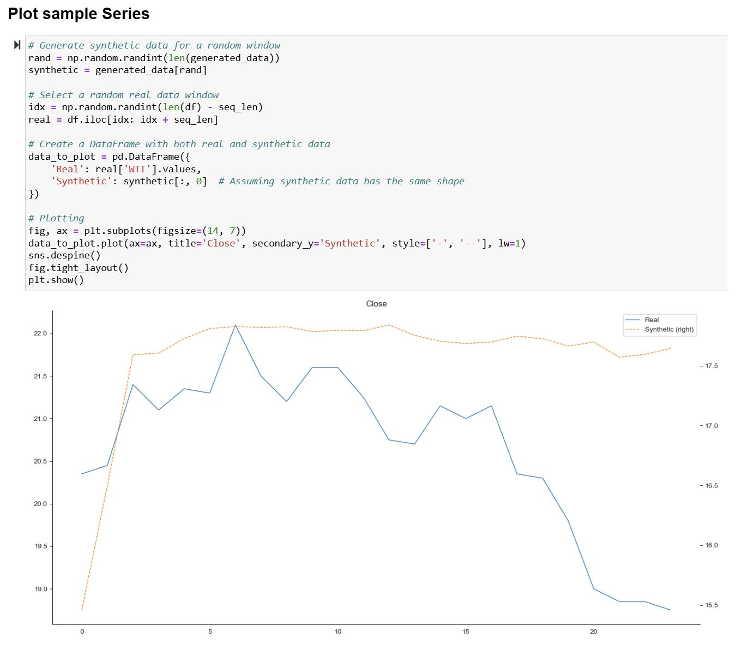
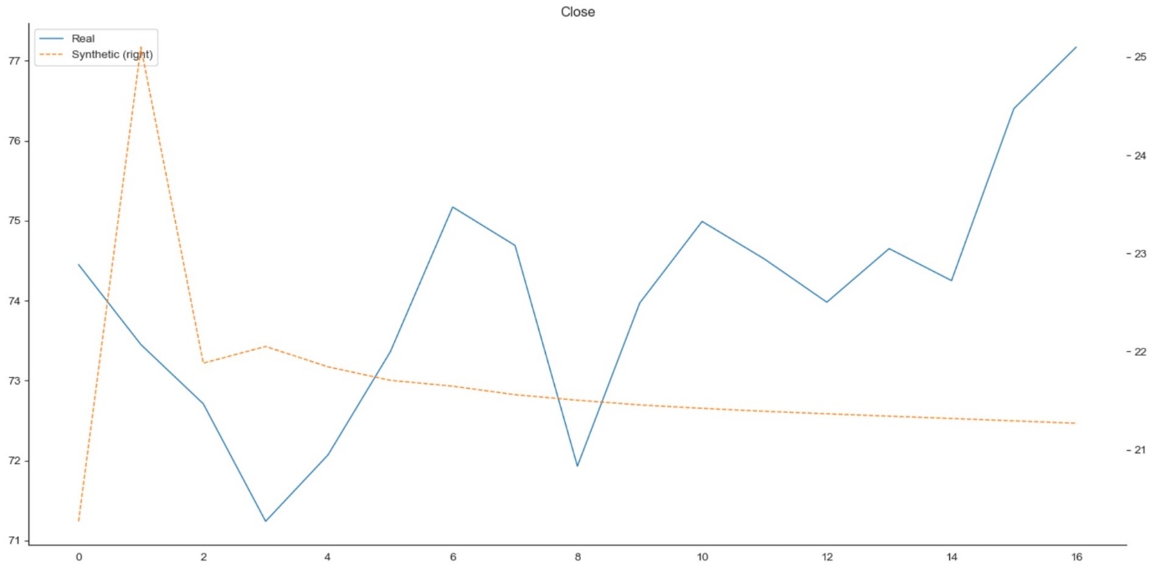
Results (with anomalies)
BEFORE
AFTER
General Trend: The synthetic data captures the overall upward and then stabilizing trend seen in the real data, indicating that the model has learned the general pattern.
Stabilization: The synthetic data shows good stability after the initial learning phase, which is a positive sign of convergence and reliability of the synthetic model.

Slide 30
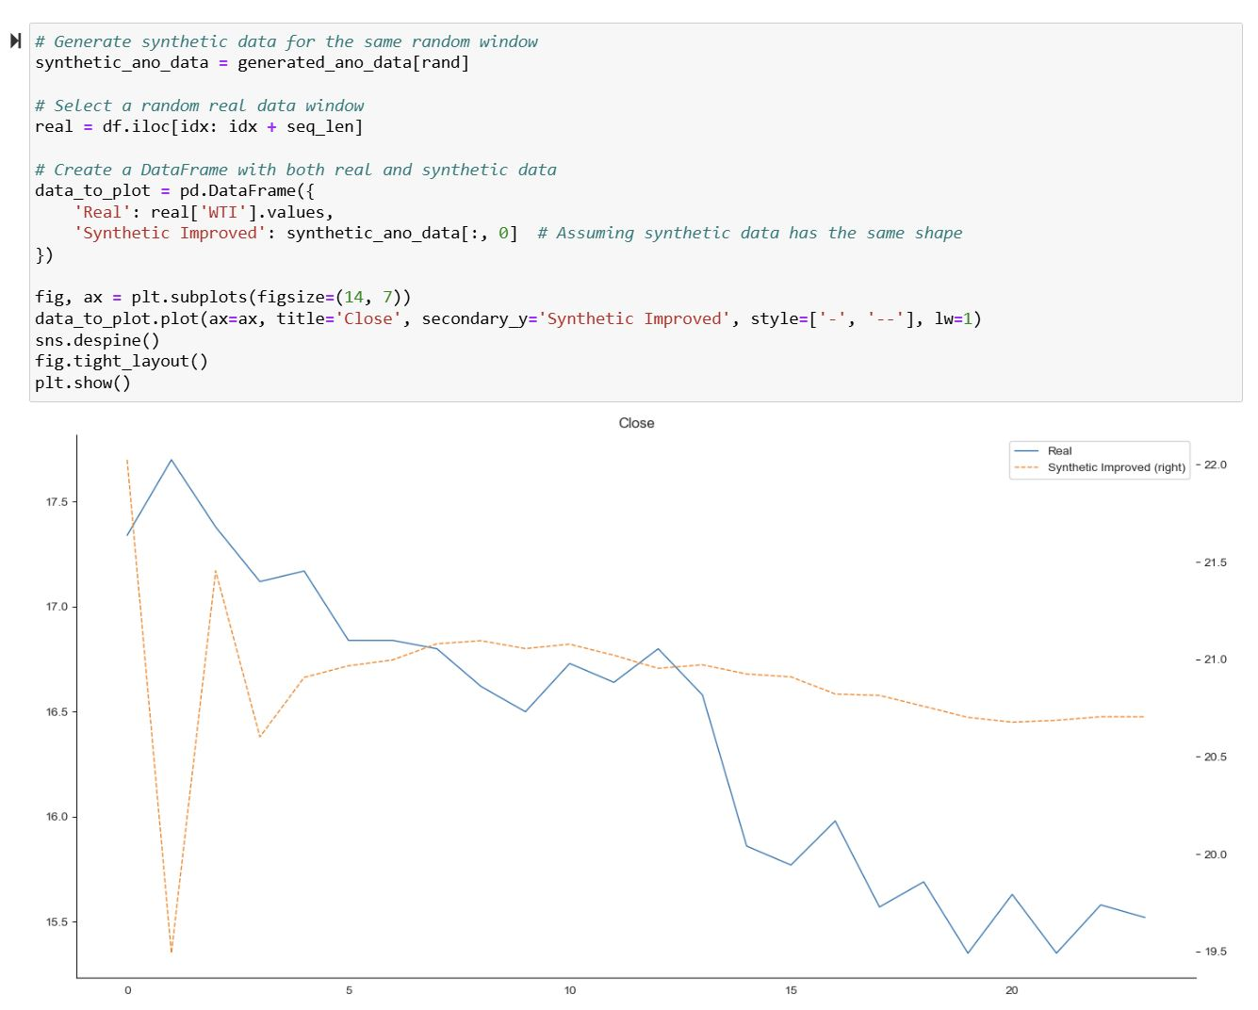
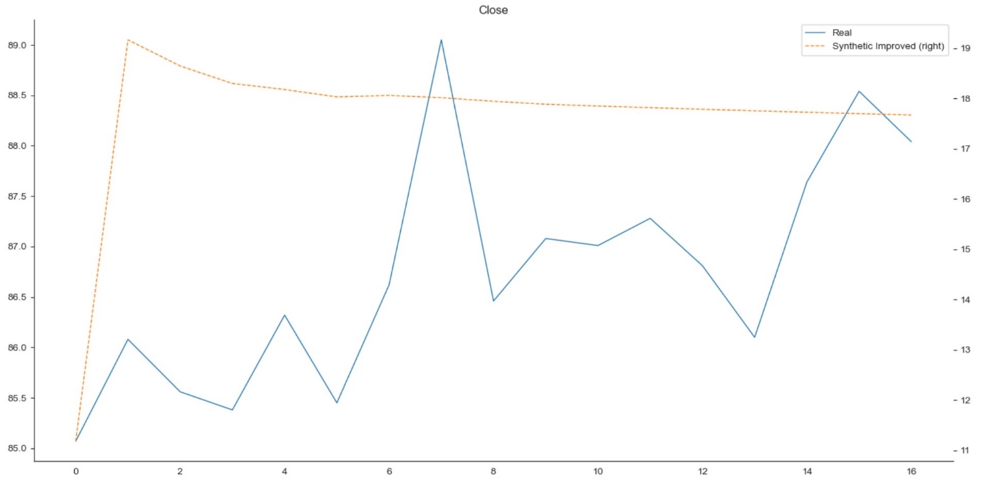
Results (without anomalies)
BEFORE
AFTER
The deviations between the "Synthetic Improved" data and the real data are beneficial for privacy purposes.
While the synthetic data captures general trends, it avoids exact replication of the real data's fluctuations and sharp changes, reducing the risk of identification. This balance ensures the synthetic data is useful for analysis while preserving the privacy of the original data.

Slide 31
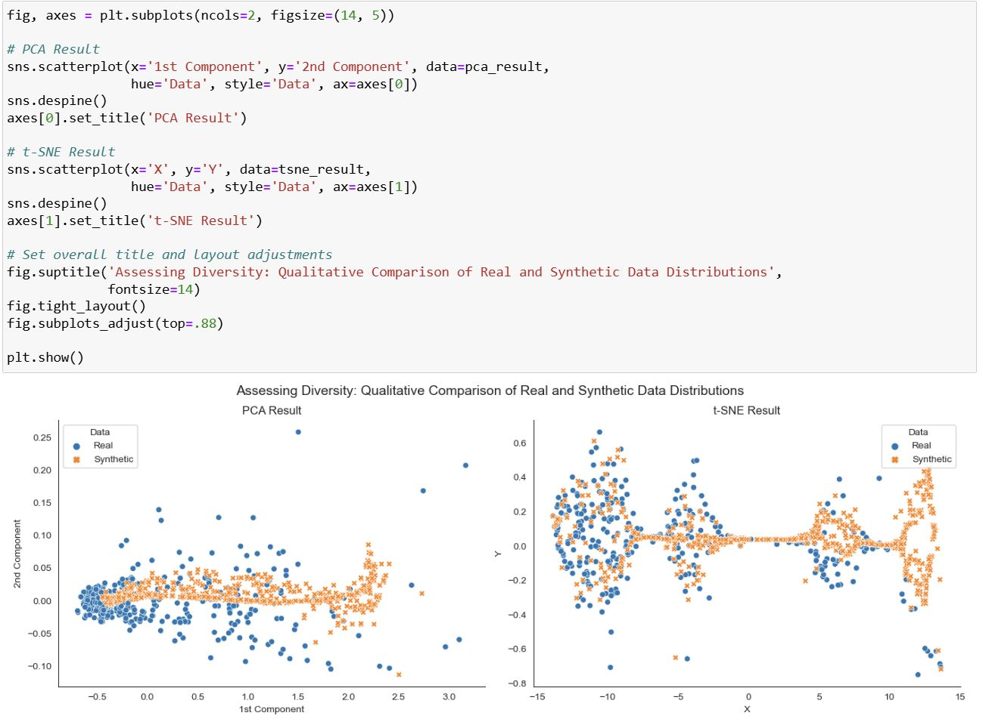
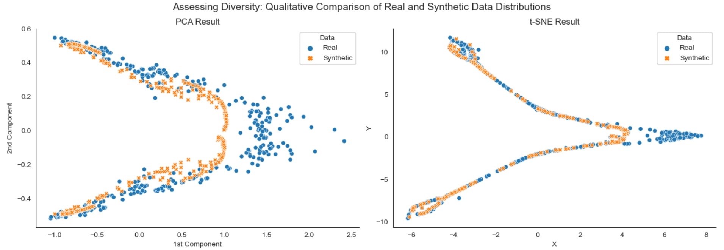
evaluation
BEFORE
AFTER
Both PCA and t-SNE visualizations show a good alignment between synthetic and real data distributions. The synthetic data captures the overall structure and clustering patterns of the real data.
The overlap in cluster structures suggests that the synthetic data retains significant analytical value. It can be used for similar analyses as the real data without compromising privacy.

Slide 32
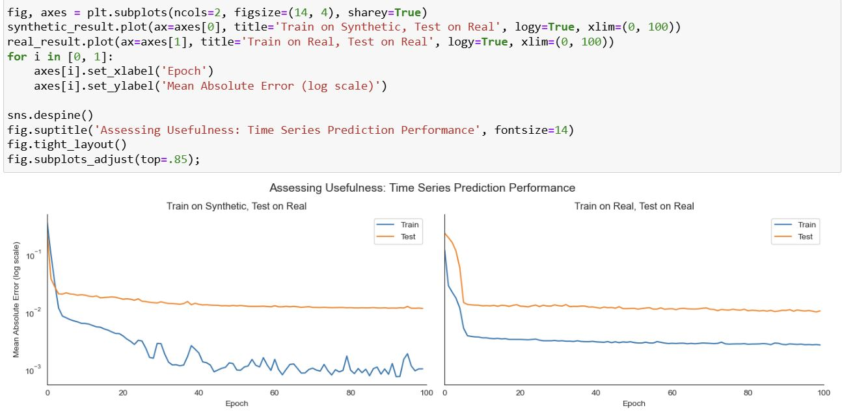
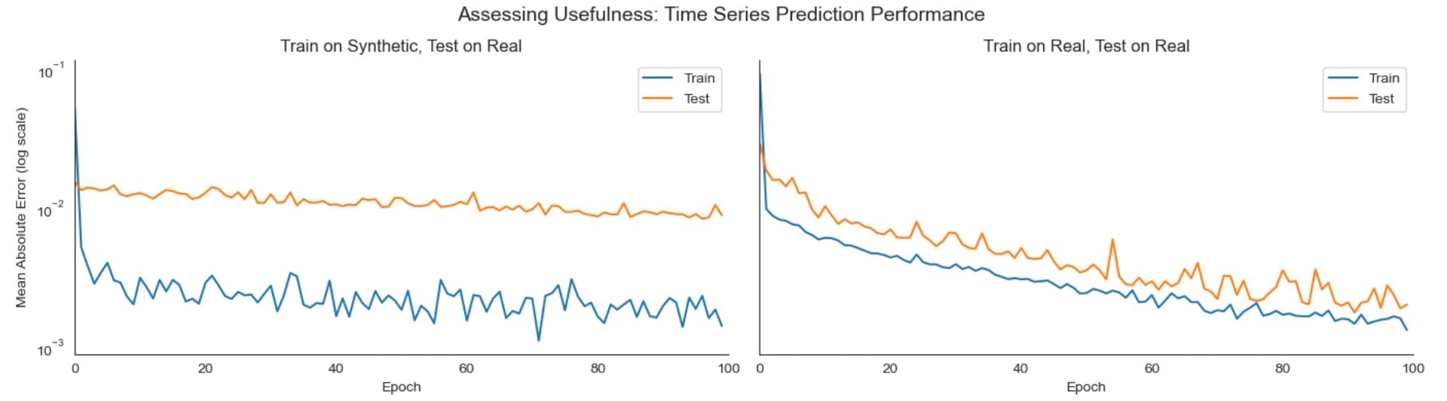
evaluation
BEFORE
AFTER
Synthetic data does not perfectly capture the characteristics of the real data
The decreasing MAE on both sets indicates better generalization and usefulness of real data for training.

Slide 33
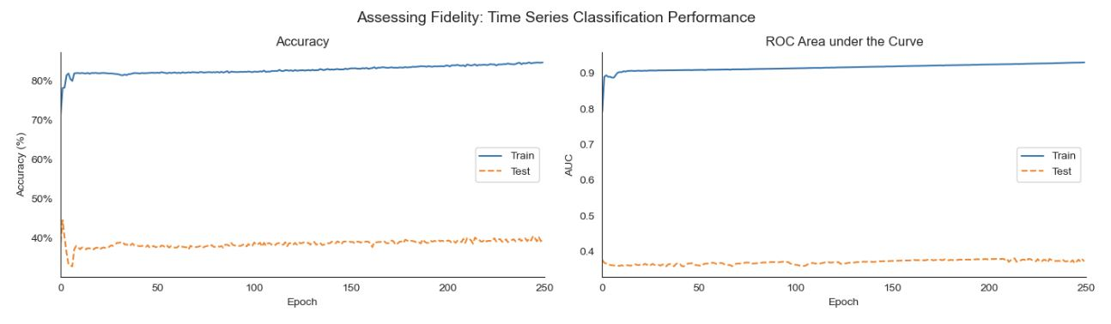
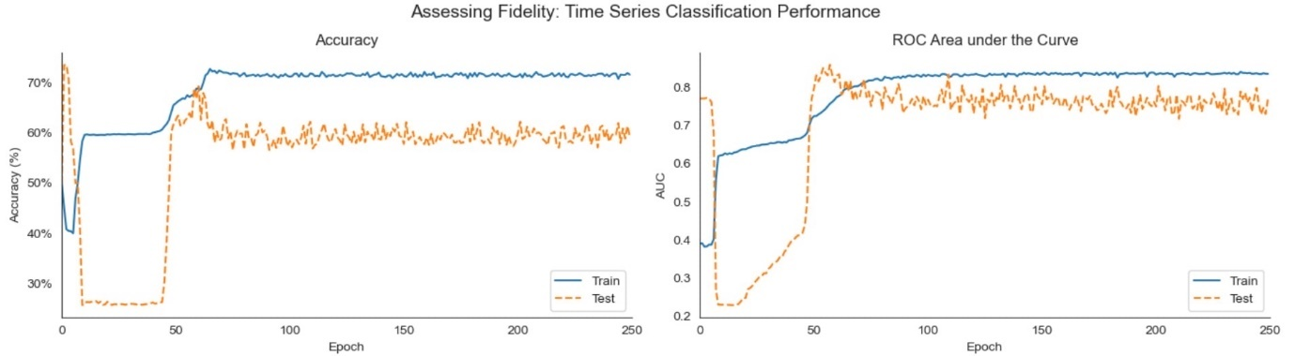
Evaluation
BEFORE
The model quickly learns to discriminate between classes in the training data.
The model displays good generalization performance on unseen data
Model converged and is no longer learning significantly from the training data after 60-70 epochs
AFTER

Slide 34
Future work
Synthetic data generation on anomalies

Slide 35

THANK YOU! Any questions?

